Slide 1
PART OF SPEECH TAGGING FOR HINDI LANGUAGE
Presented By-
Devashish Katoriya
Bhushan Shilawat
Ashutosh Bhawsar
Ninad Kapadnis
K. K. Wagh Institute of Engineering Education and Research, Nashik

Slide 2
Introduction
Is the task of assigning POS tags to words
Selecting among more than one tags that apply
Can be used for further NLP tasks
Information extraction, Question Answering etc.

Slide 3
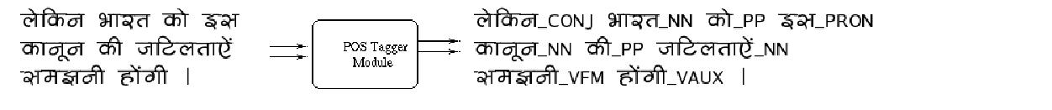
Example of POS Tagging

Slide 4
Motivation
Lack of significant tools for Indian languages
Dependence of other NLP activities on PoS tagging
Failure of existing techniques on Indian Languages

Slide 5
Existing Taggers
Rule Based Taggers
Brill tagger
Stochastic Taggers
CLAWS tagger
Tree tagger

Slide 6
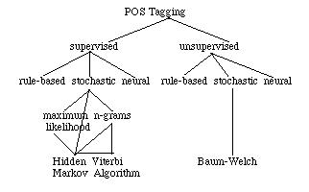
Overview of POS Tagging

Slide 7
Need for Taggers for Hindi
The existing taggers fail on Indian languages
The grammatical structure differs
Free word structure of Hindi
Stochastic taggers cannot give good performance
Morphological Information not taken into account

Slide 8
Techniques
To make efficient taggers
Get morphological information
Use heuristics to use morphological information

Slide 9
1. Morphological Perspective
Three kind of word morphologies
Verb
Noun
Adjectives

Slide 10
Morphological Perspective
Noun Morphology
Depicting possesion
laD,ka ^{Possesion} laD,ko ka
Depicting number
laD,ka ^{plural} laD,ko

Slide 11
2. Hidden Morkov Model
Why HMM
Underlying events generate surface probabilities
The models can be trained using Expectation Maximization algorithm.
Easy to port to other languages

Slide 12
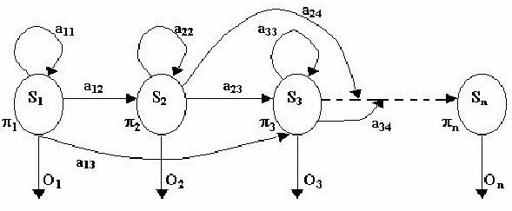
Hidden Markov Model

Slide 13
Hidden Markov Model
The Parameters
_{i} = initial state probabilities
a_{ij} = state transition probability
b_{ij} = probability of recognizing kth symbol in transition from i to j
Estimation
Initial estimation done with training data
Re-estimation done using Baum-Welch Re-estimation

Slide 14
Conclusion
The Part of Speech taggers for Hindi should morphological information
To make efficient taggers we must allow use of heuristics
Hidden Markov Models can be used for portable taggers.

